Slide 1



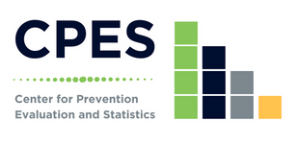

Unpacking Youth Substance Use in Connecticut:
Using Focus Group Data to Unpack the Results of the 2023 Connecticut School Health Survey
Alversia Wade, MPH
UConn School of Medicine
DMHAS Center for Prevention Evaluation and Statistics at UConn Health
CT Public Health Association (CPHA) 2024 Annual Conference
Building Healthier Communities Together: Centering on Community for Changemaking
November 18, 2024
Notes:
Unpacking Youth Substance Use in Connecticut: Using Focus Group Data to Unpack the Results of the 2023 Connecticut School Health Survey

Slide 2



1
Demonstrate the importance of using multiple data sources to explain substance use patterns among youth in Connecticut.
Learning Objectives
Discuss results of the Connecticut School Health Survey in the context of the focus group results of the DMHAS Youth and Parent Focus Group Initiative.
2
Notes:
By the end of this presentation I will demonstrate the importance of using multiple data source to explain substance use patterns among youth in CT. I will do this by discussing the results of the CSHS in the context of the focus group results from the DMHAS YPFG initiative

Slide 3
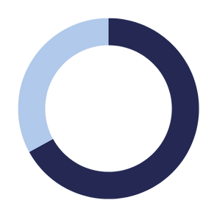


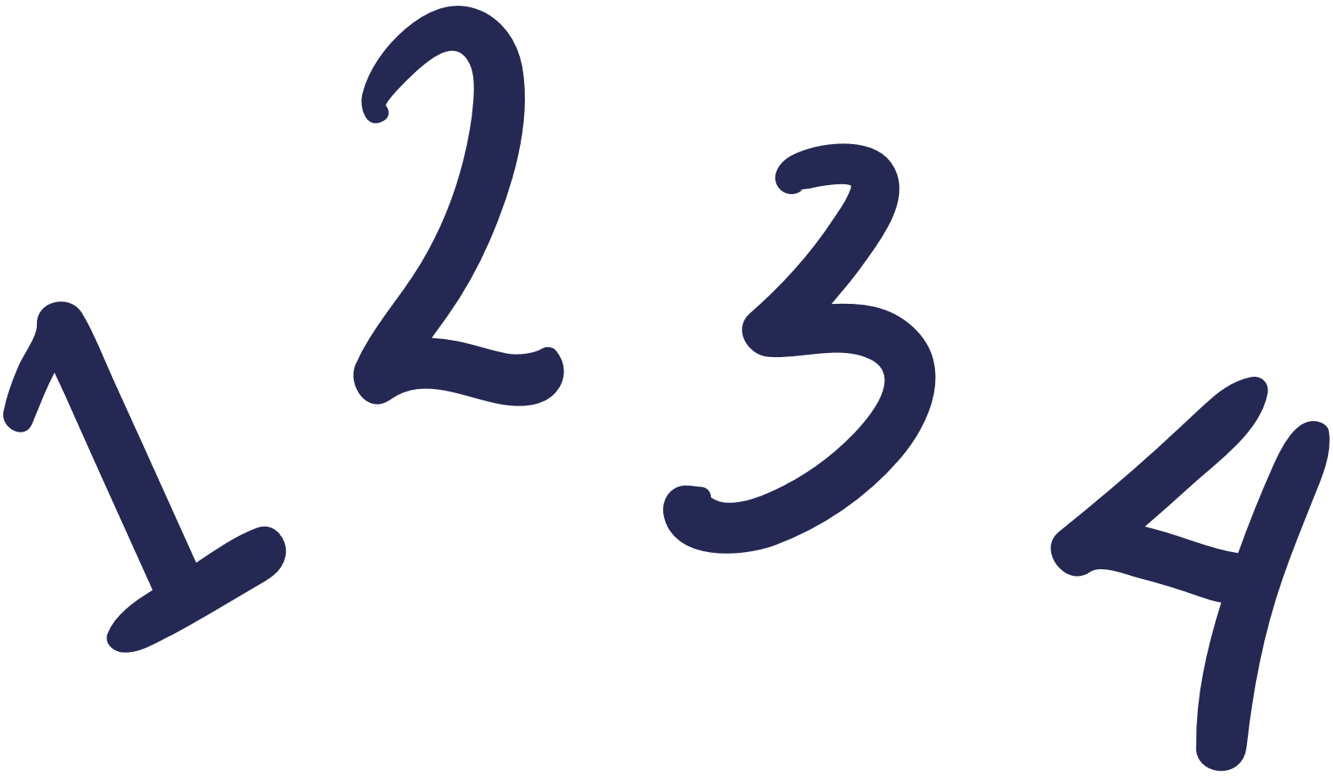


Methodology: Mixed-method Approach
Quantitative Data
Qualitative Data
Notes:
To provide a deeper understanding of youth access, perceptions, and drivers of substance use across the state, I used a mixed method approach by looking at quant and qual data
qual data perspectives can help support, amplify, illuminate, and qualify quant data findings

Slide 4
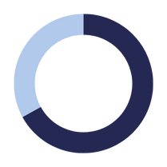
Methodology: Mixed-method Approach
Quantitative Data
Qualitative Data
  2023 Connecticut School Health Survey
  Monitor trends in health behaviors
  3,182 high school students (grades 9-12)
  50 public, charter, & vocational high schools
  February to June 2023
  2022-2023 DMHAS Youth and Parent Focus Group Initiative
  Youth perspectives on substance use
  12 high-risk communities in Connecticut
  14 youth focus groups
  March to June 2023
Notes:
qualitative data from the DMHAS Parent and Youth Focus Group Initiative was used to contextualize quantitative findings from the CSHS.
The quant data source was the 2023 CSHS which is used to monitor trends in health behaviors. 3.182 high school students from grades 9-12 were surveyed across 50 public, charter and vocational high schools rom feb to jun of 2023.
The qual data source was the 2022-2023 DMHAS PYFG Initiative that collected youth perspectives on substance use across 12 high-risk communities in CT. 14 youth focus groups were conducted from march to June of 2023.

Slide 5

CURRENT SUBSTANCE USE

Slide 6

Current Substance Use
Past 30-day Substance Use
21.1%
14.7%
11.5%
Alcohol
Marijuana
EVP
Notes:
Alcohol is most frequently used, followed by marijuana, and then evp use

Slide 7

Current Substance Use
How common is...
Past 30-day Substance Use
Vaping
1
". . . whenever you walk in bathroom, you’ll probably find people in there vaping. . . . And I know at parties, people always have vapes on them. Not everyone but a lotta people do.”
21.1%
2
Cannabis Use
14.7%
11.5%
"...I always smelt it near the bathrooms in my school or just simply would see... carts and stuff like that on the floor outside whenever I'm skateboarding. I see it everywhere wherever I go"
3
Alcohol use
“I don’t really know a lot of people that like drink daily, because it can be expensive . . . you can very easily tell if someone’s been drinking . . . I think a lot of, other substances, for example, are used daily because they’re easy to hide.”
Alcohol
Marijuana
EVP
Notes:
Youth fg perspectives is that vaping is most common, cannabis is stil in midde, and alcohol is least common which differs from frequency reported in CSHS. Vaping and cannabis use is very visible. Every day youth see vaping and cannabis use in bathrooms. Alcohol use is less visible. Less daily use because harder to hide. Youth also shared that alocohol is used at parties and other social gatherings which are not happening everday.

Slide 8

ALCOHOL USE

Slide 9
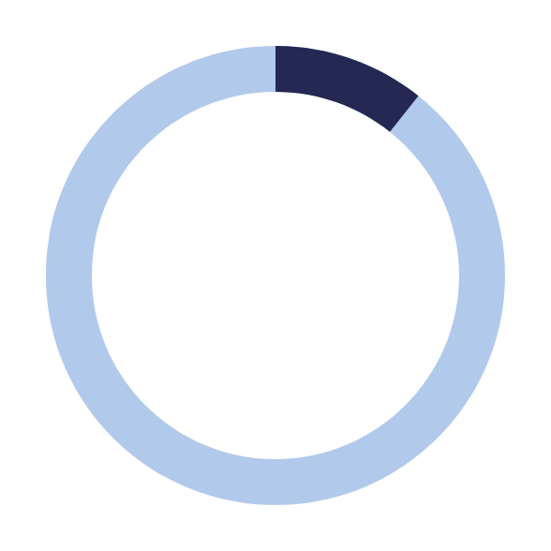
Alcohol Use
Accessibility of Alcohol
Past 30-day Alcohol Use
"In my personal experience, it's always been...from parents, places in the house, and without permission..."
"A lotta people have fake IDs... and that's kind of how most people get it. It's like there's either one person everyone knows . . . . They're like hey, you wanna give us alcohol for this?"
21.1%
Locations of Alcohol Use
"...it's more of something that people do at social gatherings . . . it's less talked about than other things like when people get high or stuff like that.”

Slide 10




ELECTRONIC VAPOR
PRODUCT USE

Slide 11


Electronic Vapor Product - Forms
Vaped marijuana
*
Vaped flavored
product
*
“There’s a lotta carts but there’s also a lotta just flavored vapes. . .”
69.1%
94.9%
". . . vapes are, like they're marketed towards young people . . . . The flavors themselves are cotton candy, unicorn, blue raspberry, it's all appealing. . ."
*Of high school students who reported current EVP use
Notes:
According to the CSHS, of hs students who reported current evp use 69.1% reported vaping marijuana in the past 30 days while 94.9% reported most often using a flavored product in their vapes. Qual perspective support these finds and expand that marketing is geared towards youth. Flavors are appealing which might explain widespread flavored product use.

Slide 12

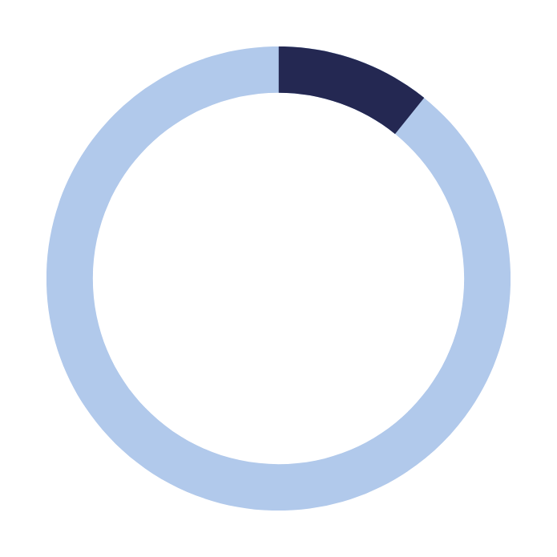
Electronic Vapor Product - Accessibility
Purchased EVP from convenience store, supermarket, discount store, or gas station
“They get it from other kids at school or they’ll go to a store that doesn’t card.”
10.8%
“. . . if there’s like one person in a friend group who vapes, then that person might share with the others.”
“. . . vapes are also very often like you can pass them around as friends. . . . Think they’re very often distributed between friends.”
Notes:
According to the CSHS. 10.8% of high students reported purchasing vape from convenience store, supermarket, discount store, or gas station. FG data clarifies that youth buy from stores tat do not card. Another perspective is that youth are getting vapes from each other. They share with their friends and vapes are pass around among friend groups.

Slide 13

CANNABIS USE

Slide 14
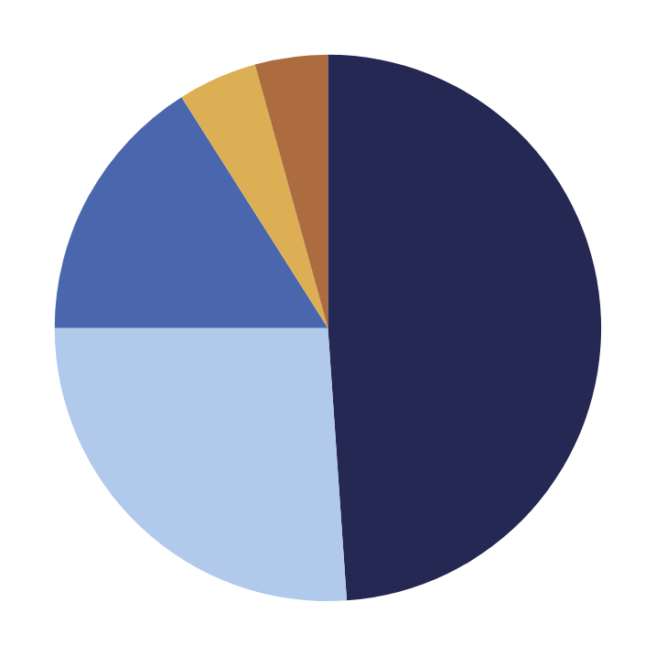
Cannabis Use - Forms
*
How did you usually use marijuana?
Other
Dabbed
4.3%
16.0%
Edibles
16.0%
Smoking
48.9%
Vaping
26.1%
*Of high school students who reported current marijuana use
Notes:
According to the CSHS, high school students who reported current marijuana use most often smoked in joint, bong, pipe or blunt, vaporized cannabis, or used edibles.

Slide 15
Cannabis Use - Forms
How did you
usually use marijuana?
*
Other
Dabbed
4.3%
16.0%
“I feel like smoking is a trend also. Not only just like weed and stuff but, you know, the vape pens and all of that. And the weed gummies. Like now people, they sell . . . cupcakes, brownies, cookies.”
Edibles
16.0%
Smoking
48.9%
Vaping
26.1%
*Of high school students who reported current marijuana use
Notes:
FG perspectives reiterate these findings. Youth smoke, they use marijuana carts in vape pens, and consume food with cannabis it like gummies, cupcakes, brownies, and cookies.

Slide 16

Cannabis Use - Perception of Risk
Perception of Risk from Regular Marijuana Use
30.2%
27.0%
22.9%
19.9%
No Risk
Slight Risk
Moderate Risk
Great Risk
Notes:
According to the CSHS, 1 in 5 high schoolers do not think that someone their age risks harming themselves by using marijuana regularly. However, there does not seem to be much difference between categories.

Slide 17
Cannabis Use - Perception of Risk
Perception of Risk from Regular Marijuana Use
30.2%
“I think I’ve seen maybe a little bit of just people thinking there’s less repercussions because of it, like it’s less dangerous since it’s legal for like older age. . . . Because if it’s legal in a few years, then what’s different about how it would affect me now?”
27.0%
22.9%
19.9%
No Risk
Slight Risk
Moderate Risk
Great Risk
Notes:
When FG participants asked about how legalization of cannabis change perception, shared thoughts of there being less repercussions and less perceived danger because it is legal for adults. Youth question if there is a difference between using as adults vs using at their current age.

Slide 18

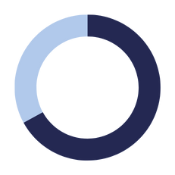
Qualitative data and quantitative data similar
  corroborate findings
  understand full picture
    add depth to findings
Conclusion
Qualitative data and quantitative differ
  indicate weaknesses of data source
    bias
    under reporting
  areas for further exploration
Notes:
In conclusion, this mxed method approach revealed areas where the qualitative data and quantitative on youth substance use were similar. This corroborates the findings between both sources and adds depth to those findins to fully understand the full picture. However, there wre times where qual ad quant differed. These differences could indicate weaknesses of sources. For example, FG perpsectives open to bias because of personal perience. CSHS is conducted in school, so students might under report because not comfortable disclosing substance use especially if that substance use is happening on school property. Differences also provide areas for future analysis and research to understand why those differences exist.

Slide 19





One form of data is not superior to another
Look for opportunities to explore data together
Final Thoughts
Use focus group to
unpack quantitative results
Useful for strategic planning
Notes:
Wrap with some final thoughts: Qual and quant data serv different purposes. One is not better than the other. When trying to understand substance use, qual and quant data should be explored together. Focus group data can be used to unpack quantitative results and gain a deeper understanding of quantitative findings. Finally, this mixed method approach is useful for strategic panning because exploration of qual and quant can help develop recommendations for prevention work by working to understand why data is similar or how it differs.

Slide 20

Contributors:
Christine Guerette
Janice Vendetti
Jennifer Sussman
Megan O’Grady
Acknowledgements
Funding Acknowledgment:
The contributors would like to acknowledge the Connecticut Department of Mental Health and Addiction Services (DMHAS) for their funding of the Youth and Parent Focus Group Initiative.

